Slide 1
Nabbihni
“Real-Time Driver Drowsiness Detector”
“A simple but important solution to reduce driving accidents led by driver drowsiness”
Supervised by : Eng / Abdulrauof Abdulmoneim
Team Members :
Abdulrahman Ashraf Albelasi
Omar Mohamed Abdelaal
Eyad Othman Mohamed
Ahmed Khaled Mohamed
Mohamed Ashraf Salem

Slide 2
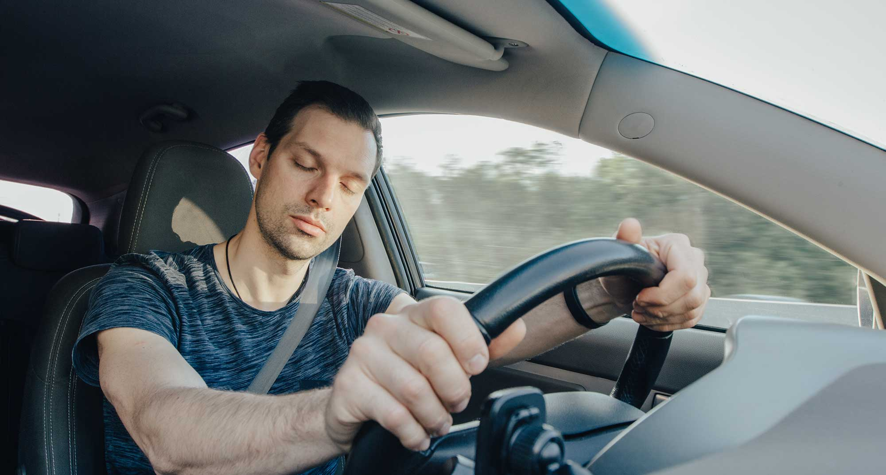
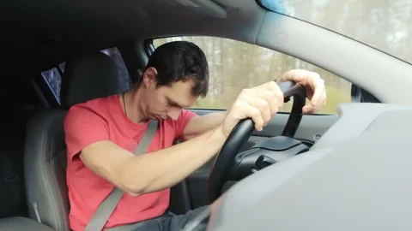

Why detecting driver drowsiness is that important ?

Slide 3
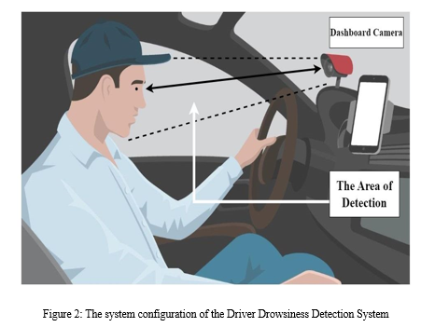
Discussion about how to apply it in the car

Slide 4
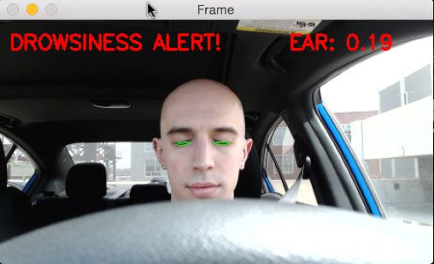
Real implementation of the project and the expected results

Slide 5
Thanks For Your Time !

